Slide 1
Deep Learning for
Time Series in TensorFlow
Priyanka Verma
2016B3A70492P

Slide 2
TensorFlow

Slide 3
Backend
C++
Python
directs traffic between the pieces
provides high-level programming abstractions to hook them together.

Slide 4
Procedure
dataflow graphs—structures that describe how data moves through a graph, or a series of processing nodes.
Each node in the graph represents a mathematical operation,
each connection or edge between nodes is a multidimensional data array, or tensor.

Slide 5
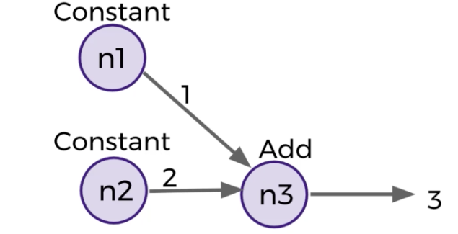
Graphs
In TensorFlow each node is an operation with possible inputs that can supply some output.

Slide 6
Components in Graph
There are two main types of tensor objects in a Graph:
Variables
state of graph
size needs to be specified
initialized before running the graph in a session
Placeholders
An “empty” node that needs a value to be provided to compute output.
external input data
size can be varied
value to be assigned later

Slide 7
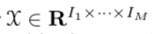
Tensors
A tensor X ∈ RI1 ×···×IM is a multidimensional array with elements that can each be indexed by a vector of positive integers. That is, every element X_{i1···iM} ∈ R is uniquely addressed by a vector
(i₁, ..... , i_{M} ) such that 1 ≤ i_{m} ≤ I_{m} for all m
Each of the M dimensions of X is called a mode and represents a particular component of the data
Vectors are tensors with only a single mode, while matrices are tensors with two modes.
Each element in the Tensor has the same data type, and the data type is always known.
The shape (that is, the number of dimensions it has and the size of each dimension) might be only partially known.

Slide 8
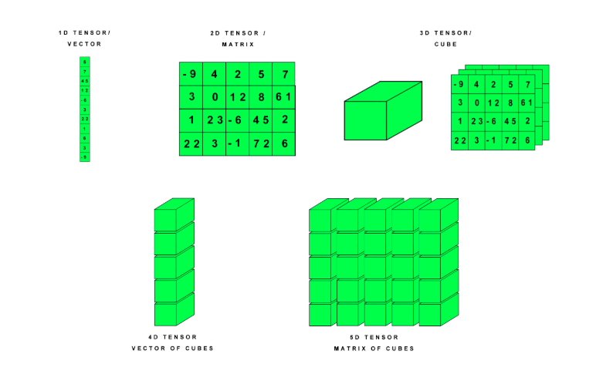

Slide 9
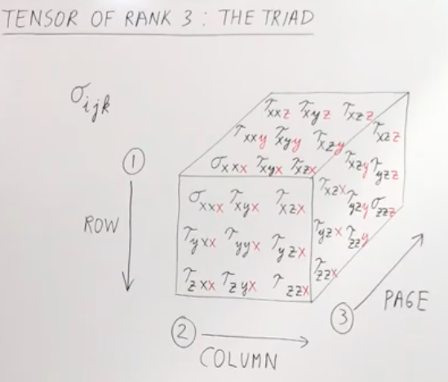

Slide 10
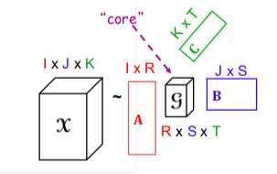
Data Pre-processing
Feature extraction from tensors involves their decomposition or dimension reduction or matricization in order to extract meaningful low-level features. Prominent decomposition methods include: block term decompositions, tucker decompositions, and canonical polyadic decompositions
Tucker Decomposition

Slide 11
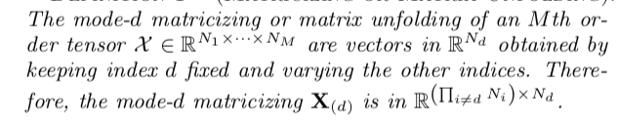
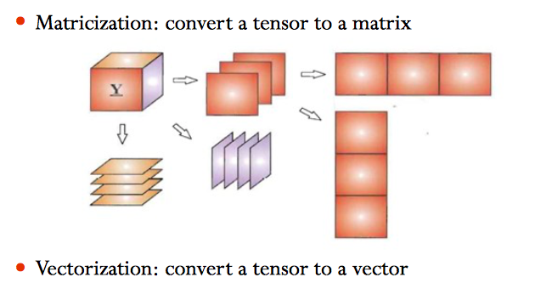
Matricizing or Matrix Unfolding

Slide 12
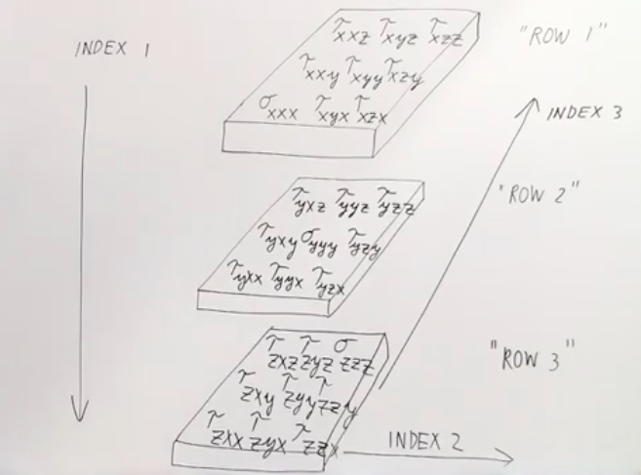
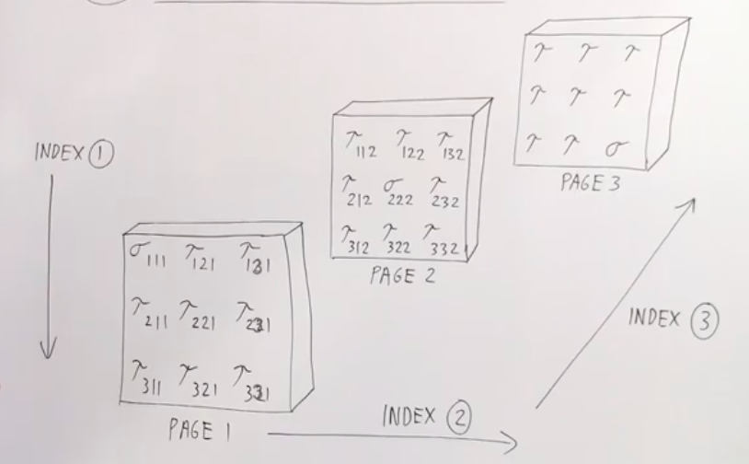

Slide 13
Models for Time Series

Slide 14
Time Series data
Stock Prices
(week_of_data, minutes, high_low_price)
If we had a 10 different stocks, with one week of data each, we would have a 4D tensor with the following shape:
(10,5,390,3)
Mutual fund,
a collection of stocks, which is represented by our 4D tensor.
A collection of 25 mutual funds representing our portfolio, so now we have a collection of 4D tensors, which means we have a 5D tensor of shape:
(25,10,5,390,3)

Slide 15
Linear Dynamical System (LDS)
The Tensorflow library models time series as a linear dynamical system with parameters.
The model that is traditionally used is the linear dynamical system (LDS) with Gaussian noise, which treats the latent state and observation at each time slice as a vector. LDS is a Markovian model that assumes the dynamic behavior of the system is captured well using a small set of real-valued hidden-state variables and linear state transitions corrupted by a Gaussian noise.
Due to the model’s relative simplicity, mathematically predictable behavior, and the fact that exact inference and predictions for the model can be done efficiently
If each tensor is “vectorized”, i.e., re-expressed as a vector so that each element is indexed by a single positive integer, then an LDS can be applied. An obvious limitation of the LDS for modeling tensor time series is that the tensor structure is not preserved. Thus, it is less clear how the latent vector space of the LDS relates to the various tensor modes.
Notes:
To learn the model parameters, it uses the Kalman filter algorithm and variational inference.

Slide 16
Dynamic Tensor Analysis
DTA provides a compact summary for high-order and high-dimensional data, and it also reveals the hidden correlations:-
(a) scalable,
(b) space efficient (it does not need to store the past)
(c) fully automatic with no need for user defined parameters.

Slide 17
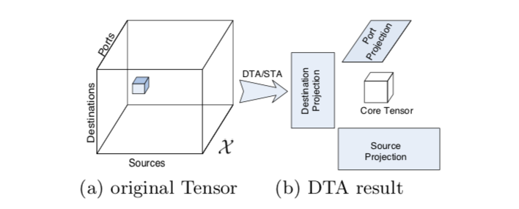
An entry (i, j, k) in that tensor (like the small blue cube) has the number of packets from the corresponding source (i) to the destination j through port k, for a given time period. The dynamic aspect comes from the fact that new tensors are arriving continuously over time.
Summarize the original tensors into smaller “core” tensors and the “projection matrices” (one for each mode), as shown. The projection matrices can be updated incrementally over time when a new tensor arrives, and contain valuable information about which, eg., source IP addresses are correlated with which destination IP addresses and destination ports, over time.

Slide 18
Dynamic Tensor Analysis
An advantage of DTA over the LDS is that the tensor structure of the data is preserved.
A disadvantage is that there is no straightforward way to predict future terms of the tensor time series.
Another disadvantage is that there is no mechanism that allows for arbitrary noise relationships among the tensor elements. In other words, the noise in the system is assumed to be isotropic.
Notes:
A latent, low-dimensional “core” tensor and a set of projection matrices are learned by processing each member Xn ∈ RI1×···×IM of the sequence as follows:- For each mode m, the tensor is flattened into a matrix Xn ∈ R k̸ =m k m and then multiplied by its transpose. that has accumulated the flattenings of the previous n − 1 tensors. The eigenvalue decomposition U ΛU T of the updated S(m) is then computed and the mth projection matrix is given by the first rank 􏰀S(m)􏰁 columns of U. After this procedure is carried out for each mode, the core tensor is updated via the multilinear transformation given by the Tucker decomposition.

Slide 19
Other isotropic models
Other families of isotropic models have been devised that “tensorize” the time dimension by concatenating the tensors in the time series to yield a single new tensor with an additional temporal mode.
These models include:-
multilinear principal components analysis
the memory-efficient Tucker algorithm
Bayesian tensor analysis or (Bayesian probabilistic tensor factorization (BPTF) )
For fitting to data, such models rely on alternating optimization methods, such as alternating least squares, which are applied to each mode

Slide 20
Anisotropic models
Probabilistic tensor factorization (PTF)
utilize the CP decomposition of tensors. PTF is fit to tensor data by minimizing a heuristic loss function that is expressed as a sum of tensor inner products.
Tensor probabilistic independent component analysis (TPICA)
utilize the CP decomposition of tensors.
TPICA iteratively flattens the tensor of data, executes a matrix model called probabilistic ICA (PICA) as a subroutine, and decouples the factor matrices of the CP decomposition that are embedded in the “mixing matrix” of PICA.
Generalized coupled tensor factorization (GCTF)
GCTF relates a collection of tensors by a hidden layer of disconnected tensors via tensor inner products, drawing analogies to probabilistic graphical models.

Slide 21
References
https://www.ncbi.nlm.nih.gov/pmc/articles/PMC5098501/
https://www.youtube.com/watch?v=jrAo6h580PU
http://www.cs.cmu.edu/~christos/PUBLICATIONS/kdd06DTA.pdf
http://aima.cs.berkeley.edu/~russell/papers/nips13-tensor.pdf
Notes:
13 Sep, 2019

Slide 22
Modelling Images as Tensors

Slide 23
Images
Single image as 3D tensor
Tensorflow works with batches of images
Accepts a batch of images each with shape inputSize x inputSize x color_depth.
Effectively, [None, inputSize, inputSize, 3] . Where None means every value from 1 to infinity.
The tensorflow network accepts batch of images and executes the predictions in parallel.

Slide 24
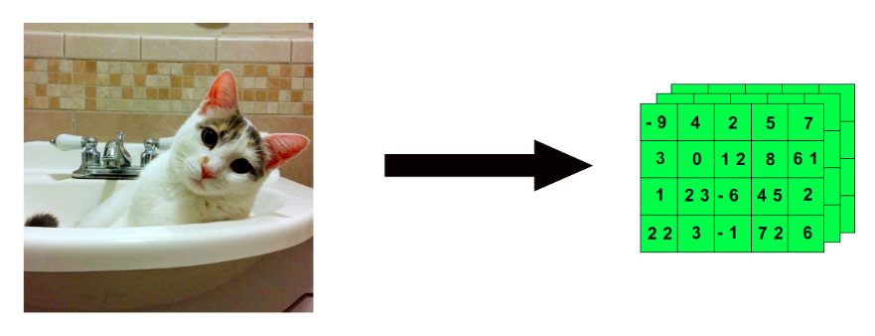
Color images
Depth depends on resolution and encoding
JPG image would use RGB and so it would have a color depth of 3
Gray Scale images :
Color_depth = 1

Slide 25
Videos
Modelled as a 4D tensor :- (no. of frames,width, height, color_depth)
Example : 5 minute video (60 seconds x 5 = 300), at 1080p HD (1920 pixels x 1080 pixels) at 15 sampled frames per second ( 300 seconds x 15 = 4500 frames), with a color depth of 3, we would store that a 4D tensor that looks like this:
(4500,1920,1080,3)
we had 10 videos just like that top one, we would have a 5D tensor of shape:
(10,4500,1920,1080,3)

Slide 26
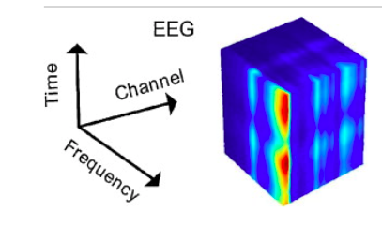
Modelling Signals as Tensors

Slide 27
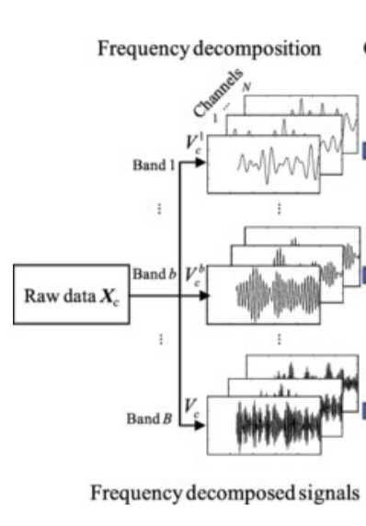
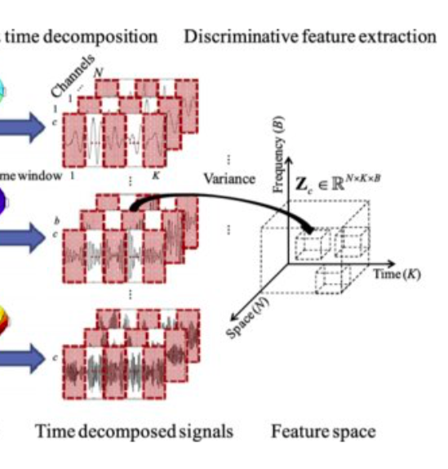
Can be modelled in 3D tensors

Slide 28
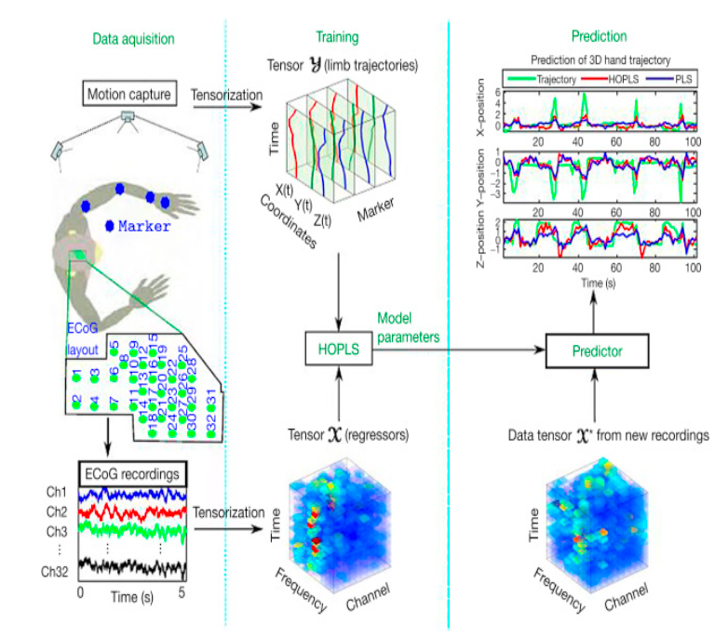
Multidimensional Signal Processing

Slide 29
Modelling Text Data as Tensors

Slide 30
store text data in a 3D tensor
Example:- tweets
Tweets are 140 characters. the first 128 characters are the based on ASCII. A single tweet could be encapsulated as a 2D vector of shape (140,128)
Collection of Tweets :- (number_of_tweets_captured, tweet, character)
If we downloaded 1 million tweets we would store that as 3D tensor of :- (1000000,140,128)

Slide 31
Other Data Structures

Slide 32
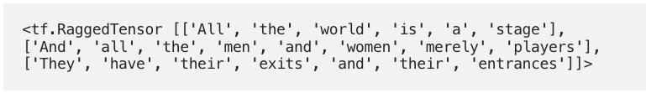
Ragged Tensors
Used to store and process non-uniform shaped data
TensorFlow equivalent of nested variable-length lists
Example: text documents that are subdivided into sections, paragraphs, sentences, and words

Slide 33
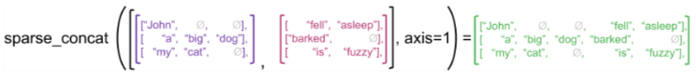
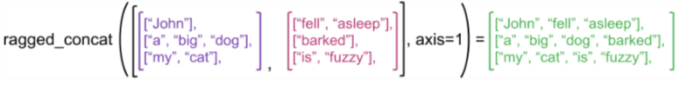
Ease of Operations
Concatenation is eased with use of ragged tensor

Slide 34
References
https://hackernoon.com/learning-ai-if-you-suck-at-math-p4-tensors-illustrated-with-cats-27f0002c9b32
https://stackoverflow.com/questions/44645849/what-is-the-shape-of-an-image-tensor-in-tensorflow
https://medium.com/tensorflow/introducing-ragged-tensors-ac301c31fd38
https://www.researchgate.net/publication/261483616_Non-homogeneous_spatial_filter_optimization_for_EEG-based_brain-computer_interfaces/figures?lo=1
http://www.cs.cmu.edu/~christos/TALKS/15-SIGMOD-tut/sigmod15-tut-note-part3.pdf
https://www.sciencedirect.com/topics/engineering/multidimensional-signal-processing

Slide 35
Neural Networks

Slide 36
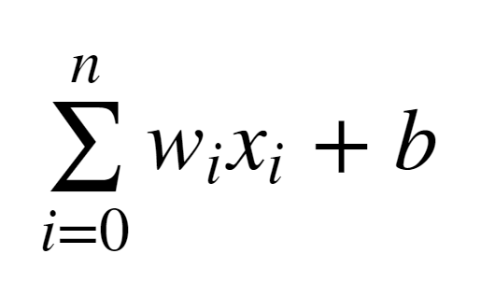
Perceptron :- simplest model
12
Weight 0
Input 0
Activation function
Output
Weight 1
4
Input 1
+ 1
Bias

Slide 37
Activation Function
12
Weight 0
Input 0
Activation function
Output
Weight 1
4
Input 1
+ 1
Bias

Slide 38
Allow modelling complex non-linear relationships by modifying inputs with non-linear functions
Activation functions typically have the following properties:
Non-linear
Continuously differentiable — to improve our model with gradient descent
Fixed Range — squash the input data into a narrow range that makes training the model more stable and efficient.
Examples:- - Rectified Linear Unit (ReLU) - tanh
0
Notes:
Activation functions give neural networks their power.
If our neuron instead outputted 0 or 1 (perceptron), we wouldn’t know in which direction to update our weights to reduce our error.
ReLu and tanh tend to have the best performance,

Slide 39
Cost Function
The loss function has its own curve and its own derivatives which measures how far off we are from the expected value
The slope of this curve tells us how to change our parameters to make the model more accurate
Used to update our parameters
Example:
Quadratic Cost
C = Σ(y-a)2 / n
Cross Entropy
C = (-1/n) Σ (y⋅ln(a) + (1-y)⋅ln(1-a)
a: predicted value by passing data in activation function y is true value
Notes:
Is cross-entropy loss always better than squared-error loss for deep learning tasks?
No, it’s not necessary that cross-entropy always performs better than squared-error loss.
Consider a case when ReLU is the activation function of the output layer in a network. Unlike softmax it will not produce results that always lie in the interval
(0,1)
(0,1) , which may lead to the values such as
0
0 or
0/0
0/0, producing undefined mathematical values when the cross-entropy error (non-differentiable gradients) is found.
Cross-entropy loss is the dissimilarity between two different probabilistic distributions and is sensible only when the values under consideration are probabilistic values
i.e
i.e they satisfy the two following conditions-
Values belong to the interval
(0,1)
(0,1).
The sum of all these values must be
1
1.
Therefore, cases where the values don’t satisfy the above-mentioned properties, a network using squared-error loss will outperform the one using cross-entropy loss.

Slide 40
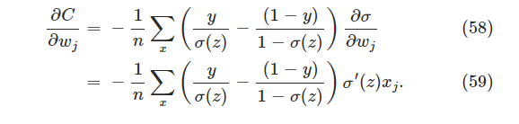
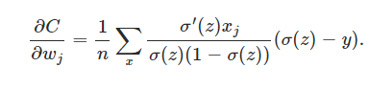
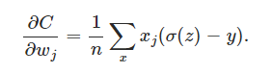
Backpropagation
Based on loss function we attempt to correct our prediction, in other words, “learn”
How to quickly adjust the optimal parameters or weights across our entire network
Example: in case of cross- entropy the learning is faster and proportional to difference in errors

Slide 41
Convolution Neural Network

Slide 42
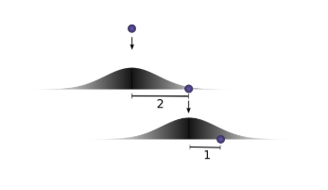
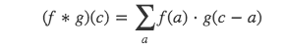
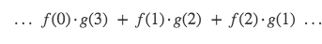
Mathematics behind Convolutions

Slide 43
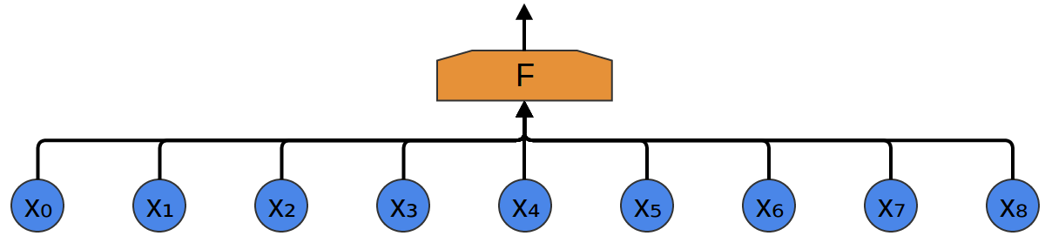
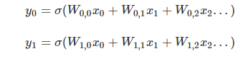
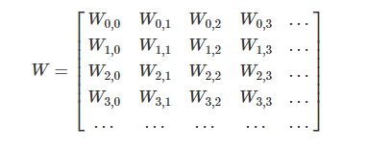

Slide 44
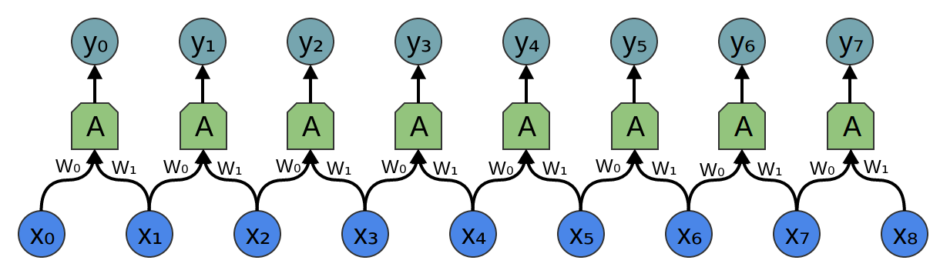
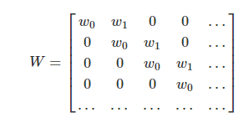
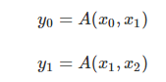

Slide 45
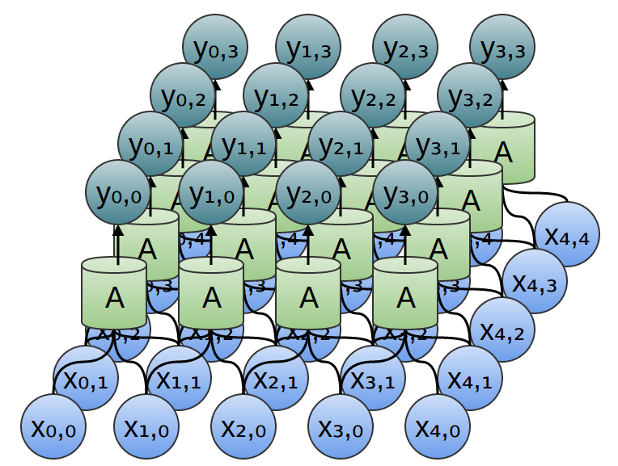
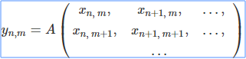
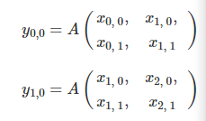
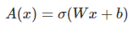
yn=A(xn,xn+1,...)

Slide 46
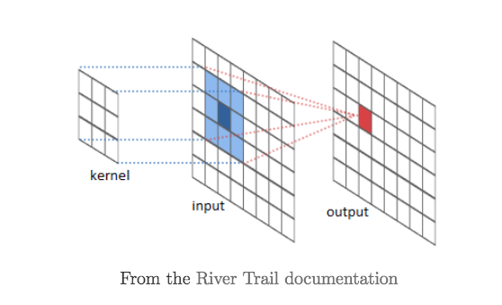

Slide 47
Applications of CNNs
When we want to preserve local properties of the data
The role of the ConvNet is to reduce the images into a form which is easier to process, without losing features which are critical for getting a good prediction
This is important when we are to design an architecture which is not only good at learning features but also is scalable to massive datasets.
applications in Computer Vision (CV) and Natural Language Processing (NLP)
Example:- extract the high-level features such as edges, from the input image.

Slide 48
Recurrent Neural Networks

Slide 49
Recurrent Neuron
memory cells
Output at t-1
Output at t
Output at t+1
Output
=
Σ
Σ
Σ
Σ
Input
Input
at t-1
Input at t
Input at t+1
Time

Slide 50
Applications
applications in Computer Vision (CV) , speech recognition, language modeling, translation, image captioning
modeling of time-dependent and sequential data tasks
Shortcoming :- where the gap between the relevant information and the place that it’s needed is small, RNNs can learn to use the past information.
Notes:
I grew up in France… I speak fluent French.” as that gap grows, RNNs become unable to learn to connect the information.

Slide 51
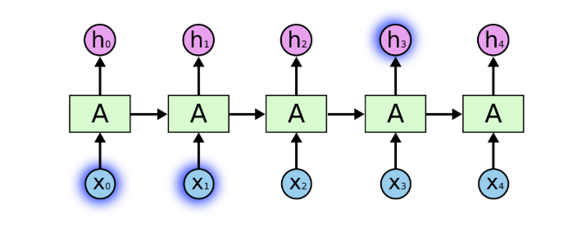
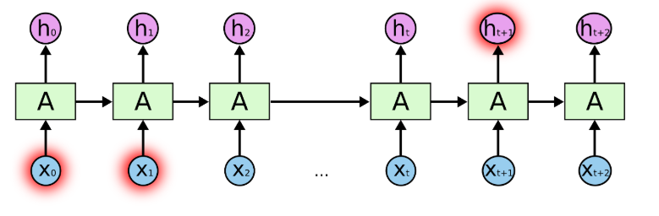

Slide 52
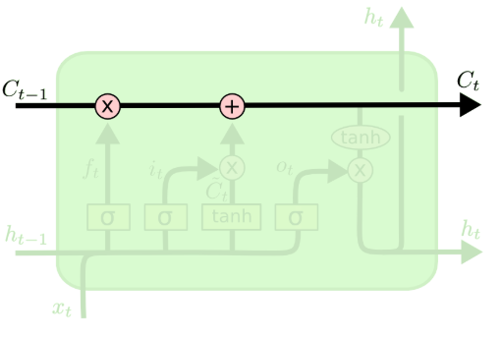
Long Short Term Memory networks (LSTM )
explicitly designed to avoid the long-term dependency problem. Remembering information for long periods of time is practically their default behavior
key to LSTMs is the cell state
Notes:
http://colah.github.io/posts/2015-08-Understanding-LSTMs/
cell state is kind of like a conveyor belt. It runs straight down the entire chain, with only some minor linear interactions.

Slide 53
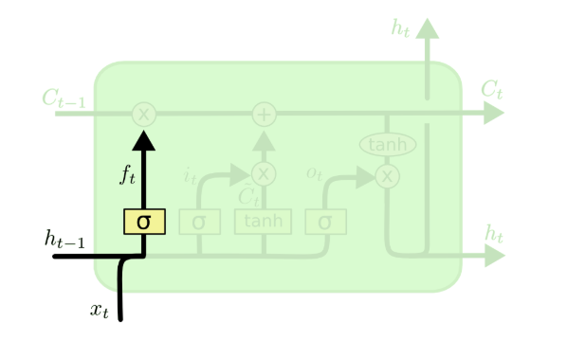
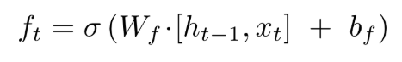
LSTM has three gates, to protect and control the cell state. Each gate is composed out of a sigmoid neural net layer and a pointwise multiplication operation. The LSTM does have the ability to remove or add information to the cell state, carefully regulated by structures called gates
“forget gate layer”
Notes:
It looks at ht−1 and xt, and outputs a number between 0 and 1 for each number in the cell state Ct−1. A 1 represents “completely keep this” while a 0 represents “completely get rid of this.”
language model trying to predict the next word based on all the previous ones. In such a problem, the cell state might include the gender of the present subject, so that the correct pronouns can be used. When we see a new subject, we want to forget the gender of the old subject

Slide 54
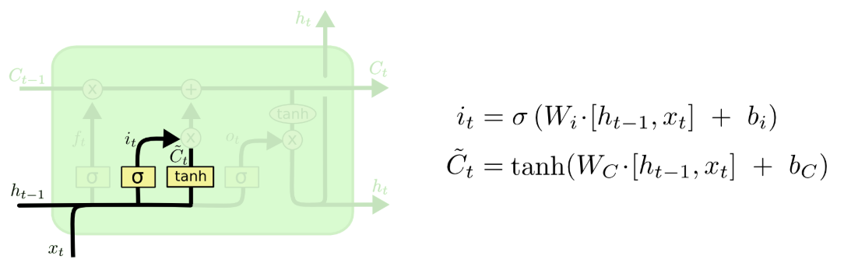
decide what new information to store in the cell state
“input gate layer” : decides which values to update
“tanh layer”: creates a vector of new candidate values, C̃ t, that could be added to the state
Notes:
we’d want to add the gender of the new subject to the cell state, to replace the old one we’re forgetting.

Slide 55
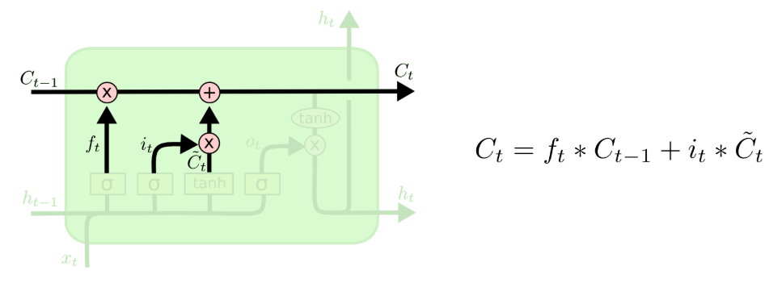
update the old cell state, Ct−1, into the new cell state Ct
multiply the old state by ft, forgetting the things we decided to forget earlier
add it∗C̃ t. This is the new candidate values, scaled by how much we decided to update each state value.
Notes:
actually drop the information about the old subject’s gender and add the new information, as we decided in the previous steps.

Slide 56
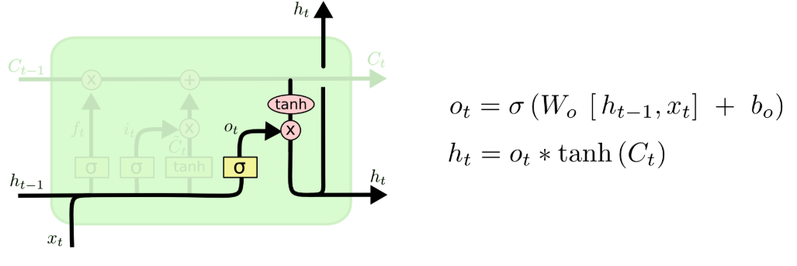
decide what to output
First, we run a sigmoid layer which decides what parts of the cell state we’re going to output.
we put the cell state through tanh (to push the values to be between −1 and 1)
multiply it by the output of the sigmoid gate, so that we only output the parts we decided to
Notes:
For the language model example, since it just saw a subject, it might want to output information relevant to a verb, in case that’s what is coming next. For example, it might output whether the subject is singular or plural, so that we know what form a verb should be conjugated into if that’s what follows next.

Slide 57
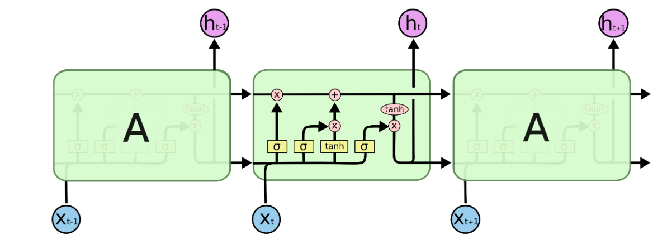

Slide 58
Example to model RNN Data
t=0 t=1 t=2 t=3 t=4
[ The, brown, fox, is, quick]
[ The, red, fox, jumped, high]
words_in_dataset[0] = [The, The]
words_in_dataset[1] = [brown, red]
words_in_dataset[2] = [fox,fox]
words_in_dataset[3] = [is, jumped]
words_in_dataset[4] = [quick, high]
num_batches = 5, batch_size = 2, time_steps = 5

Slide 59
Reinforcement Learning

Slide 60
making decisions sequentially
learning algorithm is trained not on preset data but rather based on a feedback system as next input depends on the output of the previous input
semi-supervised learning model :- Contrary to supervised learning the decision is made on the initial input or the input given at the start
Markov Decision Processes (MDPs).
An MDP is defined via a state space S, an action space A, a function of transition probabilities between states (conditioned to the action taken by the decision maker), and a reward function.
In its basic setting, the decision maker takes and action, and gets a reward from the environment, and the environment changes its state. Then the decision maker senses the state of the environment, takes an action, gets a reward, and so on so forth. The state transitions are probabilistic and depend solely on the actual state and the action taken by the decision maker. The reward obtained by the decision maker depends on the action taken, and on both the original and the new state of the environment.

Slide 61
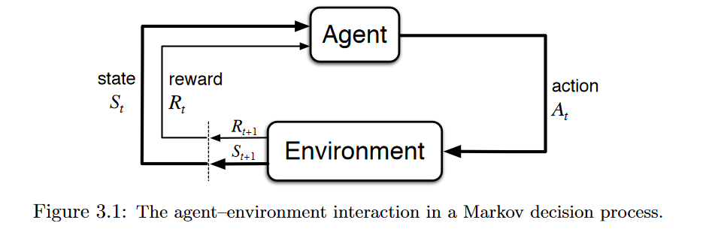
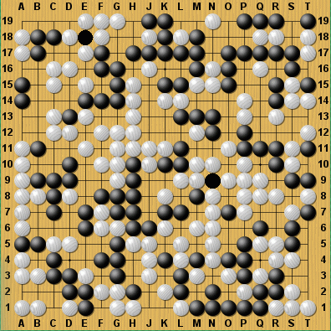

Agent
Environment
Action
Reward
Agent
Observations
Reward
Environment

Slide 62
Applications
computational neuroscience to model decision making process
Robotics
solve different games and sometimes achieve super-human performance

Slide 63
Generative Adversarial Network (GAN)

Slide 64
used for unsupervised learning
two competing neural network models which compete with each other and are able to analyze, capture and copy the variations within a dataset
misclassifying things by adding only a small amount of noise into the original data. Surprisingly, the model after adding noise has higher confidence in the wrong prediction than when it predicted correctly. The reason for such adversary is that most machine learning models learn from a limited amount of data, which is a huge drawback, as it is prone to overfitting

Slide 65
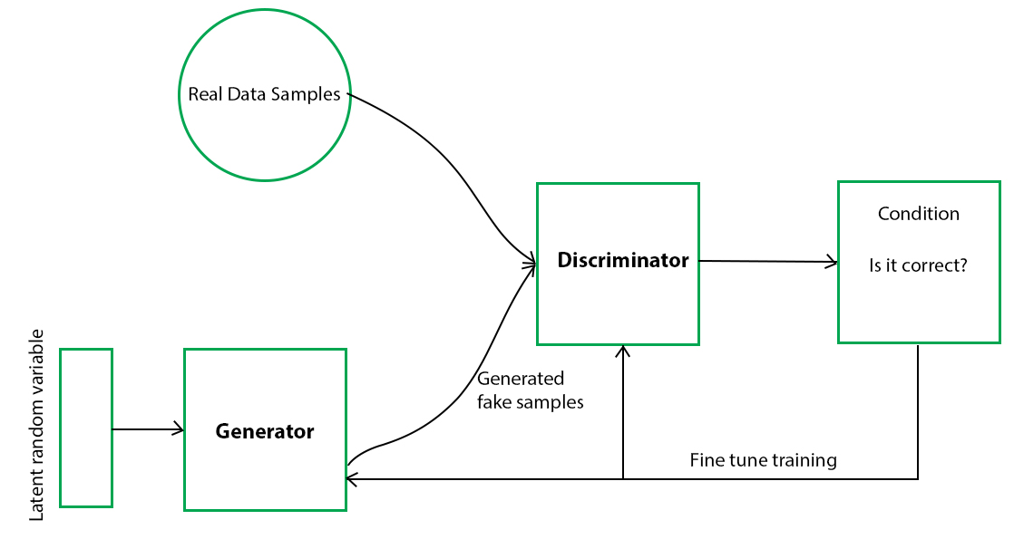

Slide 66
training a GAN:
Part 1: The Discriminator is trained.
only forward propagated. The Discriminator is trained on real data for n epochs, and see if it can correctly predict them as real. Also, in this phase, the Discriminator is also trained on the fake generated data from the Generator and see if it can correctly predict them as fake.
Part 2: The Generator is trained.
After the Discriminator is trained by the generated fake data of the Generator, we can get its predictions and use the results for training the Generator and get better from the previous state to try and fool the Discriminator.

Slide 67
Implementation

Slide 68
In the neural network terminology:
one epoch = one forward pass and one backward pass of all the training examples
batch size = the number of training examples in one forward/backward pass. The higher the batch size, the more memory space you'll need.
number of iterations = number of passes, each pass using [batch size] number of examples. To be clear, one pass = one forward pass + one backward pass (we do not count the forward pass and backward pass as two different passes).
Advantages of using a batch size < number of all samples:
It requires less memory. Since you train the network using fewer samples, the overall training procedure requires less memory. That's especially important if you are not able to fit the whole dataset in your machine's memory.
Typically networks train faster with mini-batches. That's because we update the weights after each propagation. In our example we've propagated 11 batches (10 of them had 100 samples and 1 had 50 samples) and after each of them we've updated our network's parameters. If we used all samples during propagation we would make only 1 update for the network's parameter.
Disadvantages of using a batch size < number of all samples:
The smaller the batch the less accurate the estimate of the gradient will be. In the figure below, you can see that the direction of the mini-batch gradient (green color) fluctuates much more in comparison to the direction of the full batch gradient (blue color).

Slide 69
Vanishing Gradient
Backpropagation goes backwards from the output to the input layer, propagating the error gradient.
For deeper networks issues can arise from backpropagation, vanishing and exploding gradients!
As you go back to the “lower” layers, gradients often get smaller, eventually causing weights to never change at lower levels.
The opposite can also occur, gradients explode on the way back, causing issues.
Notes:
http://neuralnetworksanddeeplearning.com/chap3.html

Slide 70
Solution to vanishing gradients
Different activation functions
ReLU doesn’t saturate positive values
Leaky” ReLU for negative values
Exponential Linear Unit (ELU)
Batch Normalisation:- normalize each batch using the batch mean and standard deviation

Slide 71
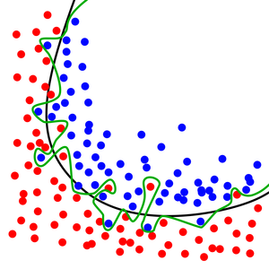
Overfitting
Neural network starts to memorize unique quirks of the training data (e.g. training data noise) instead of learning generally- applicable principles.
high performance on the training data but bad performance on the held-out test data
the model won’t be useful in the real world because it won’t perform well on data it has never seen before.

Slide 72
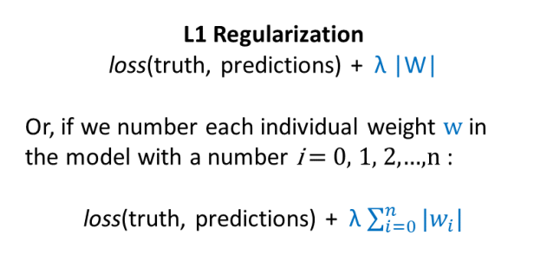
Solution to overfitting
L1, l2 regula
L1
Thus, L1 regularization adds in a penalty for having weights of large absolute value. L1 regularization encourages your model to make as many weights zero as possible
When applying L1 regularization to regression, it’s called “lasso regression.
Notes:
L1 , L2 regularisation
Dropout
Artifically expand data by adding noise terms

Slide 73

Thus, L2 regularization adds in a penalty for having many big weights. L2 regularization encourages the model to choose weights of small magnitude.If you apply L2 regularization to regression, it’s referred to as “ridge regression.”
Notes:
https://glassboxmedicine.com/2019/06/08/regularization-for-neural-networks-with-framingham-case-study/

Slide 74

One-hot encoding
Model dataset when column contain numbers of no specific order of preference and usually denotes a category or label encoded.

Slide 75
Codes

Slide 76
Manual Creation of Neural Network
https://colab.research.google.com/drive/1ZfL_huY4cEKR9ynEhX7ZAUmqrsRyOaEp#scrollTo=Ha9I1FKsBRXq
Linear Regression
https://colab.research.google.com/drive/1uMq6pZTbtMA12MPcBVeZLUio_dH-E_87
Prediction for Univariate Time Series using LSTM
https://colab.research.google.com/drive/1o_pHSBUG1BUqEtMb4Xr_lILmlr0WjYsT#scrollTo=sUaoBMixOSpd
Prediction for Multivariate Time Series using LSTMs
https://colab.research.google.com/drive/1IfoGRjhtZuQupD1Vi7n9f3aRakqutpaP#scrollTo=ZPkYvk3s4HLi
Classification of data using LinearClassifier
https://colab.research.google.com/drive/1p37tbdI4Qyy8sKoHvw19Ine6GHPVFfA_#scrollTo=h5_LVRWu4pfO

Slide 77
References
http://colah.github.io/posts/2015-08-Understanding-LSTMs/
https://glassboxmedicine.com/2019/06/08/regularization-for-neural-networks-with-framingham-case-study/

